Slide 1

Fundamentals of Humidification
Adiabatic Humidification Technologies for Decarbonization
AHRI Humidifiers Educational Working Group
Nicholas Lea, P. Eng, LEED AP BD+C
Head of Product and Sales Support Americas
Condair Ltd.
Nicholas.lea@condair.com
1 800 667 8321

Slide 2
Humidifiers Educational Working Group
^{December 19, 2024}

Slide 3
Course
Description
To face the environmental challenges of tomorrow, we must begin decarbonizing our buildings today. However, we must also take recent lessons in healthy indoor environments into consideration. In this presentation, we will explore how humidification and evaporation technologies fit into decarbonization strategies, with a particular focus on energy efficiency benefits that can be unlocked with evaporative technologies. The topic will begin with a brief review of indoor humidity terminology and theory and traditional applications for humidity control and commonly available technologies. We will then review some common drivers of decarbonization and talk about how various humidity control products may fit into decarbonization strategies. For the second half of the presentation, we will discuss evaporative humidification and cooling technologies in greater detail, including examples of direct and indirect evaporative cooling applications. We will conclude with a short overview of the latest in evaporative technologies. Attendees can expect to gain a deeper understanding of:
• Humidity control in buildings
• How decarbonization and humidity control technologies interact
• Approaches for reducing energy usage with evaporative cooling
• Modern Evaporative technologies

Slide 4
Learning
Objectives
At the end of the course, participants will understand:
Humidity terminology and humidification applications
Drivers of Decarbonization
Adiabatic cooling and physics of evaporating water
Direct evaporative cooling fundamentals
Indirect evaporative cooling fundamentals
Adiabatic technologies

Slide 5
Course Outline
Introduction
Traditional Humidification Technologies and Applications
Decarbonization
Adiabatic and Evaporative Cooling Principles
Direct Evaporative Cooling
Indirect Evaporative Cooling
Evaporative Cooling/Humidifying Technologies

Slide 6

Introduction

Slide 7
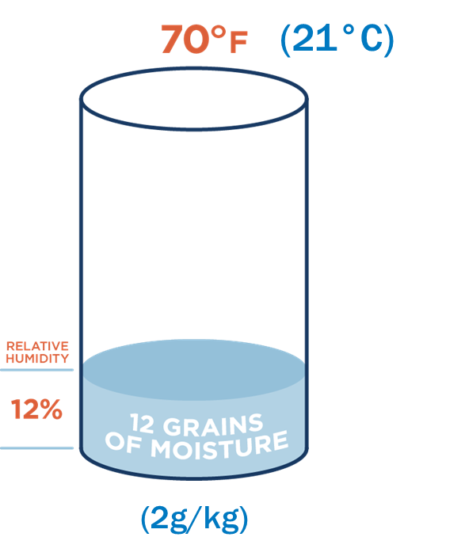
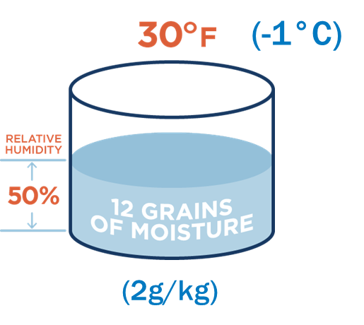
Humidity Terms and Terminology
Humidity
  The amount of water vapor in the air
  Measured in “Absolute” or “Relative” terms
Absolute Humidity
  Mass of water in a particular volume of air
  Expressed as mass (grains/lb_{da} or g_{w}/kg_{da})
Relative Humidity
  Amount of water vapor in the air relative to how much it can hold at a given temperature (%)
Sensible Heating

Slide 8
Humidity vs. Temperature Charted
Absolute Humidity
100% RH
110 gr (16g/kg)
50% RH
12 gr (2g/kg)
30°^{F}
(-1^{C})
70°^{F}
(21°^{C})
120°^{F}
(49°^{C})
Temperature

Slide 9
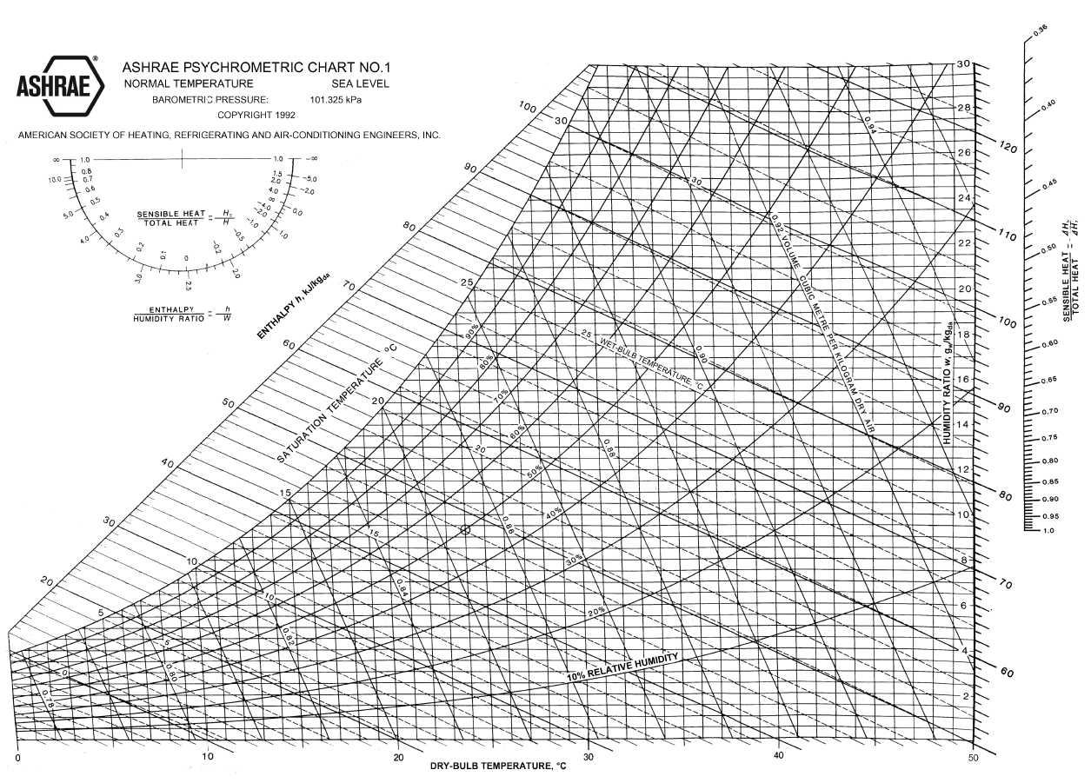
The Psychrometric Chart

Slide 10


What Causes Indoor Dryness?
Outside air with low absolute humidity dries building
Sensible Heating
Outside Air
6°F (-14°C)
53% RH
4 gr/lb (0.6 g/kg)
Inside Air
70°F (21°C)
4% RH
4 gr/lb (0.6 g/kg)
Ventilation
In/Exfiltration
Image: Free Stock Photos 14413

Slide 11
Humidification Methods and Applications

Slide 12
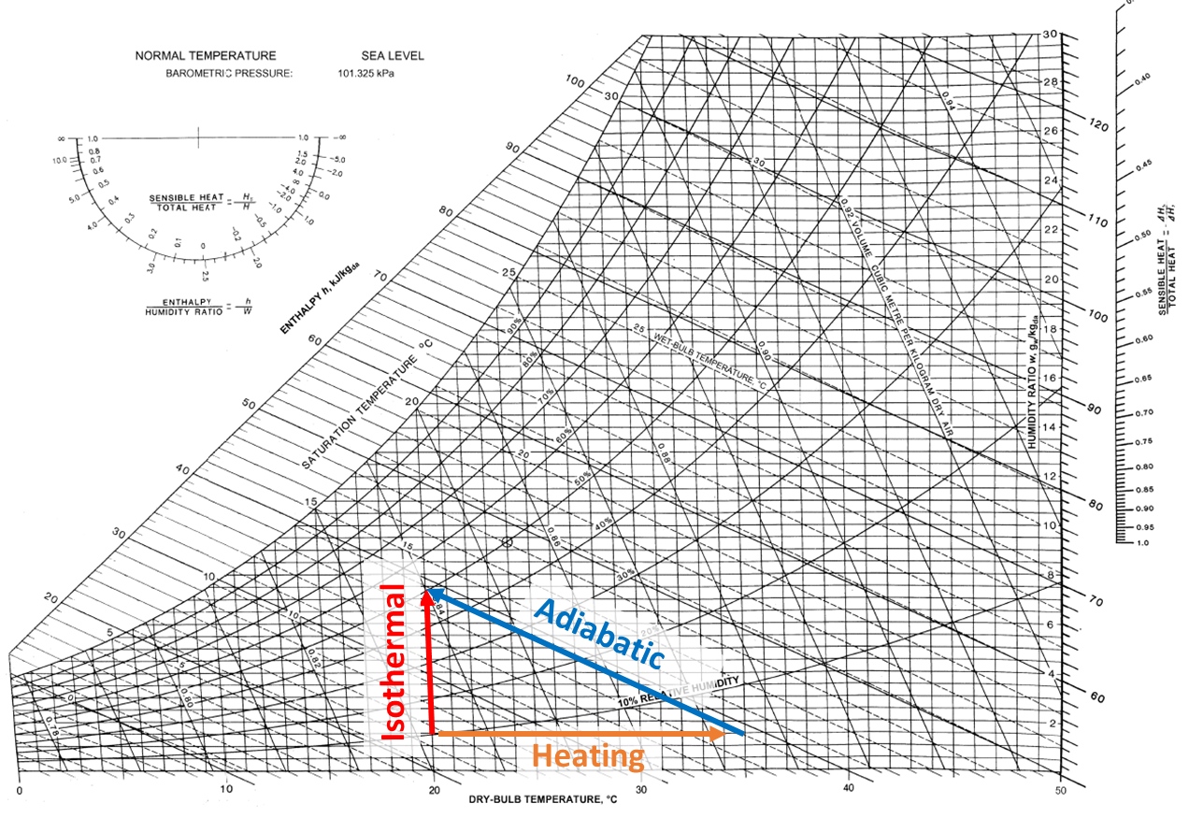

Humidification Methods
HEATING
Moisture content: Constant
Temperature: Increases
ISOTHERMAL HUMIDIFYING
Moisture content: Increases
Temperature: Constant
ADIABATIC HUMIDIFYING & COOLING
Moisture Content: Increases
Temperature: Decreases as sprayed water evaporates absorbing heat from the air

Slide 13
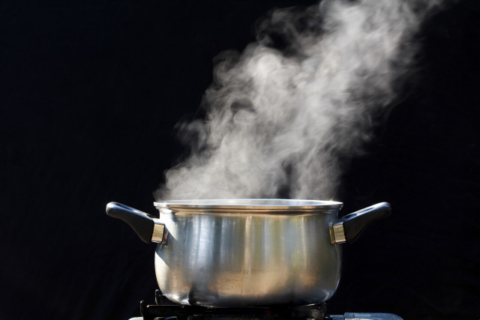
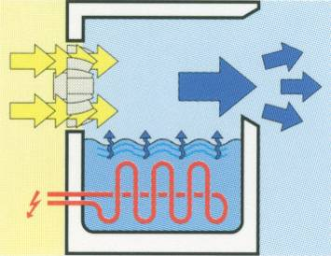
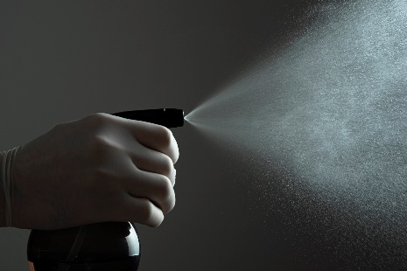
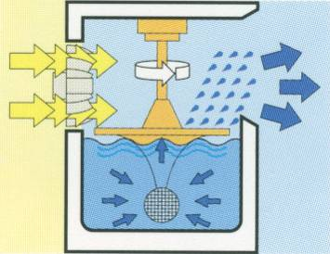
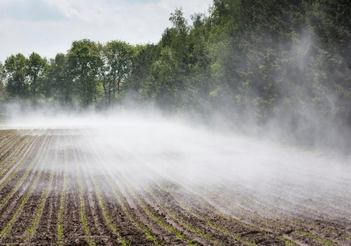
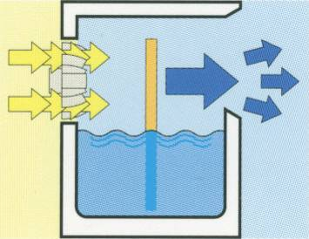
Humidification Methods
Gas Steam
Electric Steam - Electrode
Electric Steam – Resistive
Facility Steam – Direct
Facility Steam – Indirect
Isothermal
Vaporization
Nozzle Fogging
Ultrasonic Fogging
Hybrid Fogging
Evaporative Media
Atomization
Adiabatic
Evaporation

Slide 14
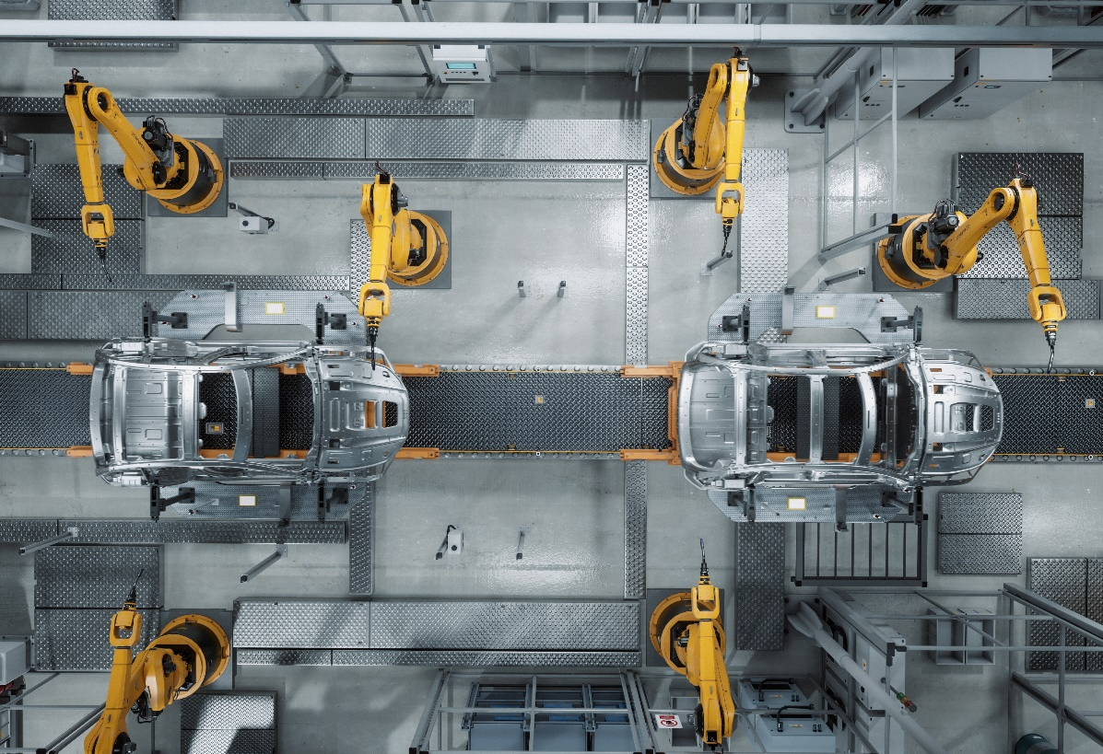



Where is Humidity Needed?
Humidity for Processes and Buildings
Applications:
Aerospace
Archives and Museums
Automotive
Clean Rooms and Labs
Data Centers
Defense
Electronics
Manufacturing
Paint and Spray Booths
Printing
Textile
Wind Energy
Woodworking
Etc.

Slide 15



Humidity for Processes and Buildings
Hygroscopic
Materials
Evaporation
Rates
Static
Charges

Slide 16




Where is Humidity Needed?
Humidity for People
Applications:
Homes
Schools
Office Buildings
Museums
Hotels and Resorts
Spas and Steam Baths
Hot Yoga
Hospitals and Care Facilities
Nursing and Retirement Homes
Gym and Fitness Facilities
Convention Centers
Concert Halls and Venues
etc.

Slide 17


Humidity Affects Human Health
Physical Effects of Dryness | Environmental Effects of Dryness
Skin Dryness Eye Dryness Throat / Vocal Irritation Reduced Immune Function Dehydration/Reduce Concentration | Increased particle virulence Increased viral particle float time Increased allergic effects Increased ozone production
Optimal Indoor Environment for People: 40 – 60% RH @ Room Temperature

Slide 18
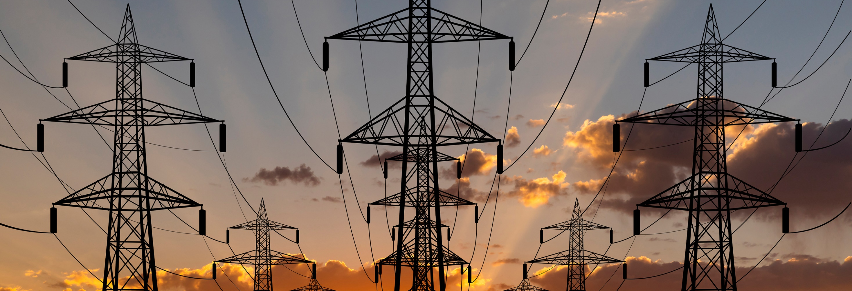
Decarbonization

Slide 19
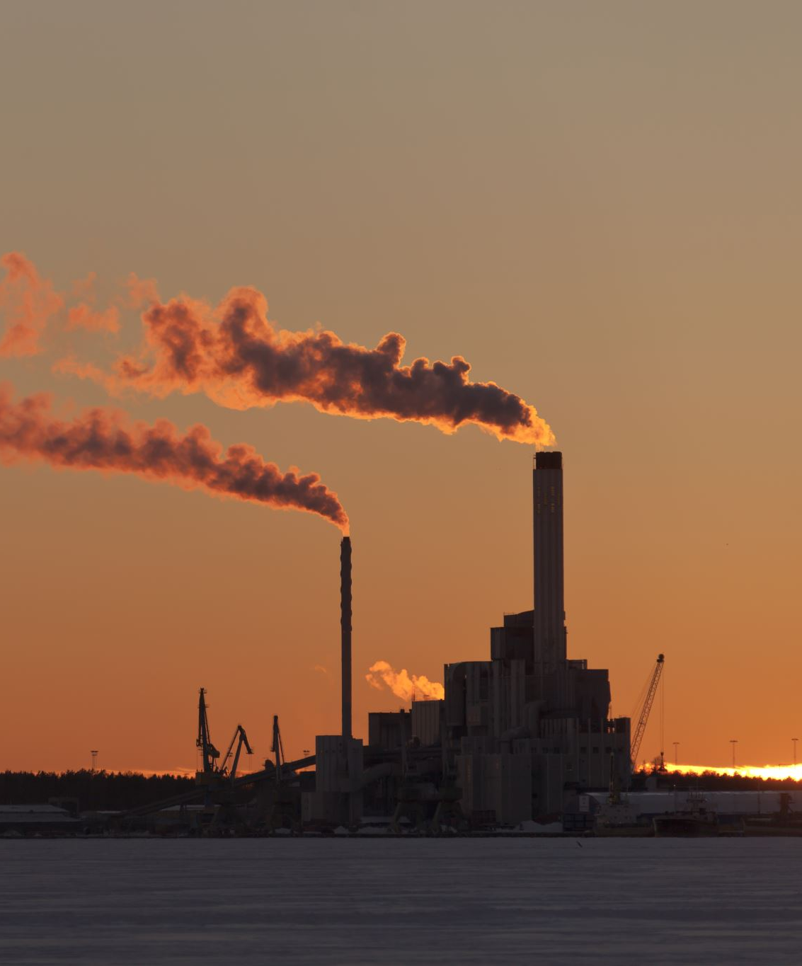
Decarbonization
Decarbonization: Reduction of direct and indirect emissions from energy & water use, embodied carbon, and refrigerants
Industry Drivers:
  Incentive Programs
  Regulations: "Buy Clean" Acts, New York City Law 97, etc
  ESG – Sustainable investing (e.g Blackrock)
  Economics – Savings
Top Trends in HVAC
  Energy efficiency
  Energy recovery - reuse waste
  Electrification
  Heat Pumps (leading electrification strategy)
  Energy Storage / demand shifting
  Low GWP refrigerants
  Advanced Controls - Sequencing, self-learning, real-time grid response

Slide 20

Decarbonization through Electrification
Electrification is an approach for decarbonizing buildings by utilizing electricity, ideally clean electricity, instead of fossil fuels
  Not all electricity is equally clean, but grid improvement continues
  Significant clean generation will need to be brought online to meet increased demand
  On-site power generation contributes and increases resilience
  Technically viable in warm and cool climates, but energy cost differences remain a challenge
  Heat pumps are major topic

Slide 21
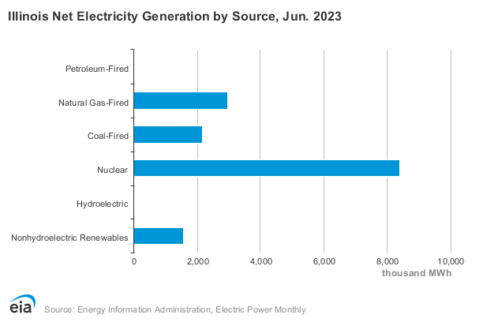
Electrification in Illinois
In Illinois, electrification is a viable method for decarbonization
  Grid is moving towards low-carbon
    High nuclear base load
    66% of generation is carbon free (1)
  Emissions Conversion Rate:
  639 lbs/MWH CO₂e (39th in USA) (2)
  Zero emission grid by 2045 (3):
    2030 for plants with high NOx or close to environmental justice district
    2035 for plants installed before 2021
    2040 for plants >7000 BTU/kWh
    2045 for all
20%
14%
56%
10%
(1) https://www.eia.gov/state/?sid=IL#tabs-4
(2) https://www.eia.gov/electricity/state/illinois/
(3) https://epa.illinois.gov/topics/ceja/electric-generating-units.html

Slide 22
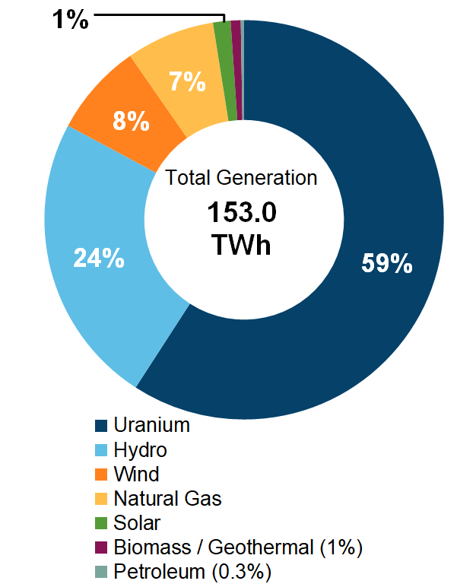
Electrification in Ontario
Electricity Generation by Fuel Type (2019) (3)
In Ontario, Electrification is a viable method for decarbonization
  Our grid is largely low-carbon
    High nuclear base load
    92% of generation is carbon free (1)
  Federal Conversion Rate: 30g CO₂e/kWH (2)
  Only the hydroelectric provinces (QC, BC, MB, and NL) are lower CO₂e
(1) https://www.cer-rec.gc.ca/en/data-analysis/energy-markets/provincial-territorial-energy-profiles/provincial-territorial-energy-profiles-ontario.html
(2) https://www.canada.ca/en/environment-climate-change/services/climate-change/pricing-pollution-how-it-will-work/output-based-pricing-system/federal-greenhouse-gas-offset-system/emission-factors-reference-values.html
(3) https://apps.cer-rec.gc.ca/ftrppndc/dflt.aspx?GoCTemplateCulture=en-CA

Slide 23
Humidification and Electrification
Gas Steam
Electric Steam - Electrode
Electric Steam – Resistive
Facility Steam – Direct
Facility Steam – Indirect
Isothermal
Vaporization
Nozzle Fogging
Ultrasonic Fogging
Hybrid Fogging
Evaporative Media
Atomization
Adiabatic
Evaporation

Slide 24
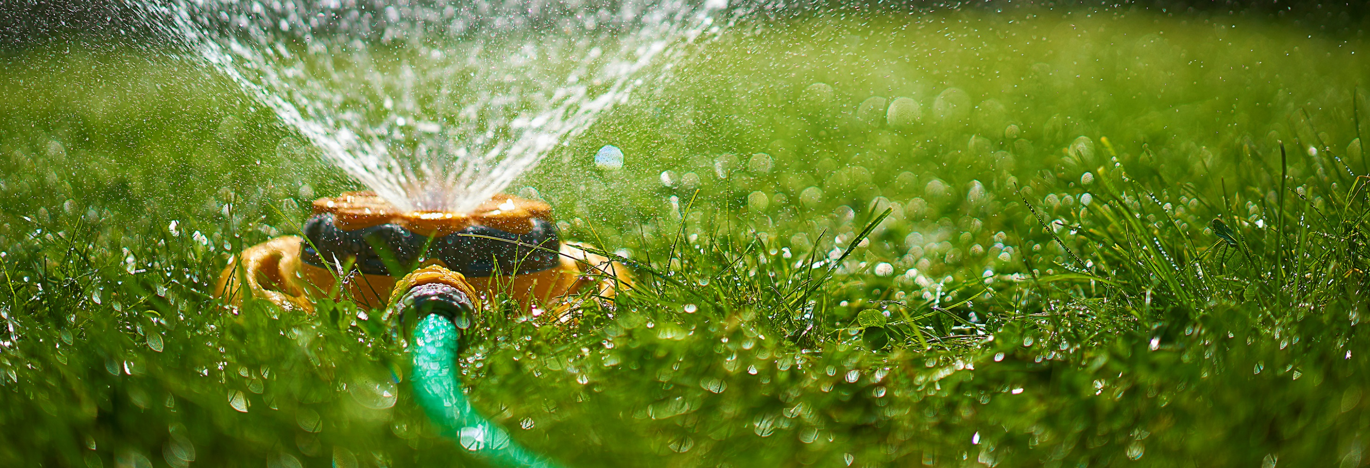
Adiabatic Principles and Evaporative Cooling

Slide 25
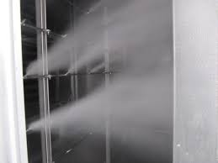
Adiabatic Humidification/Cooling:
Injects cold water directly into the air
Heat from the surrounding air allows the water to evaporate
  Air becomes more humid
  Air becomes cooler “evaporative cooling”
Can save energy and energy costs
  If cooling is beneficial the cooling can reduce mechanical cooling needs
  If cooling is not beneficial, preheating is required to offset cooling
  Total energy balance is consistent with steam humidification
Often requires water treatment
  Removes minerals from water (avoid dust)
  Reduce risk of biological contamination
May have hygiene requirements that limit use in certain applications

Slide 26
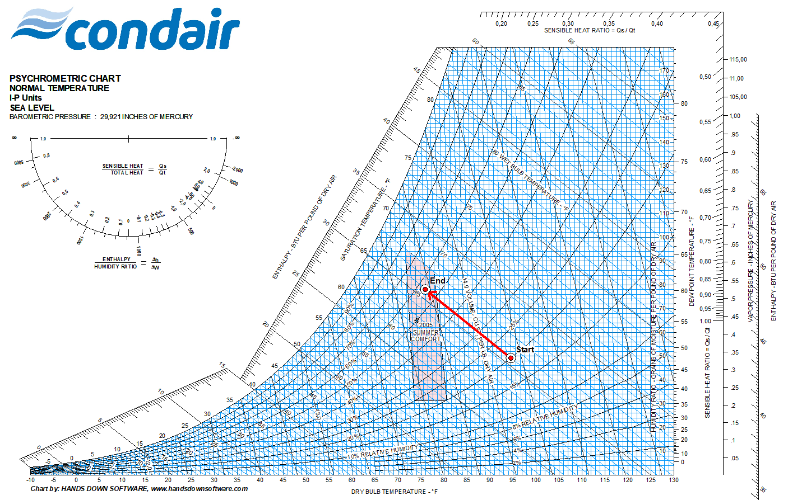
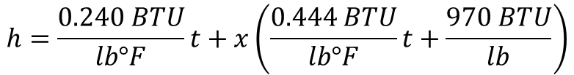
How does Evaporative Cooling Work?
When water transitions from liquid to vapor form, it absorbs energy from the surrounding air.
The air-temperature goes down - and the humidity in the air goes up.
Technically explained - there is a reduction of sensible energy and an increase in the latent energy of the air.
The total energy – or enthalpy - remains the same.
where
      h = enthalpy (BTU/lb)
      x = mass of water vapor (lb/lb)
      t = temperature (ºF)
$$h=\frac{0.240 BTU}{lb°F}t+x\left(\frac{0.444 BTU}{lb°F}t+\frac{970 BTU}{lb}\right)$$

Slide 27
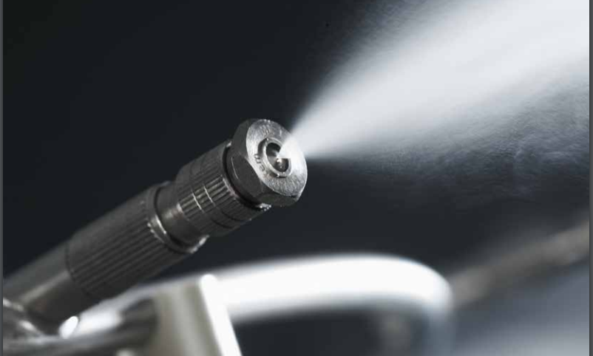
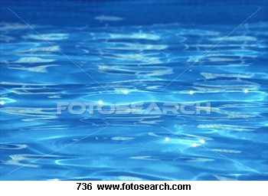
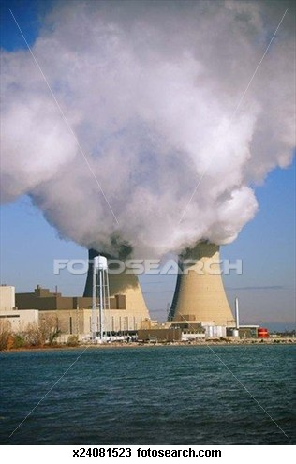
How Does Evaporative Cooling Work?
Why does it work? - Evaporation of water!
Water is spread over a wide area enabling quick evaporation in warm and dry air.
~1052 Btu/lb
~2450 kJ/kg
Evaporation
Condensation
Liquid
Vapor
The evaporation energy for water is – more or less – independent of temperature
Temperature | Energy Btu/lb | Energy kWh/lb
50 °F | 1067 | 0.313
68°F | 1054 | 0.309
86°C | 1046 | 0.306
140°F | 1015 | 0.297
Difference: 2.2 %

Slide 28
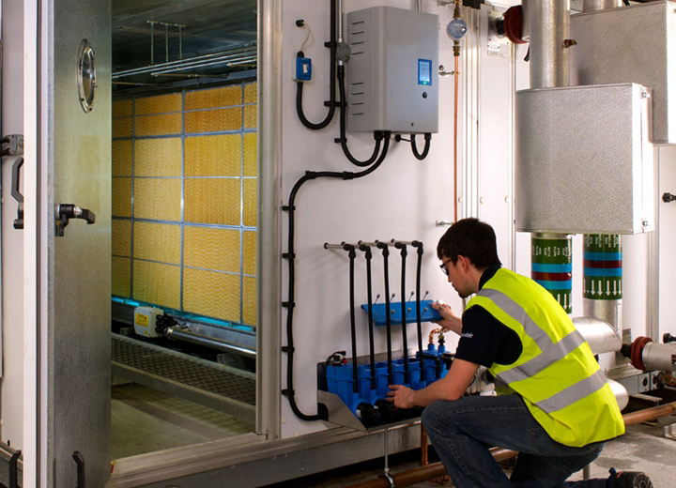
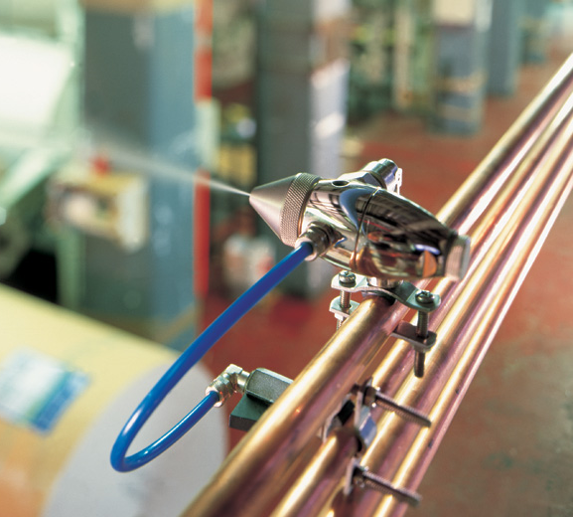
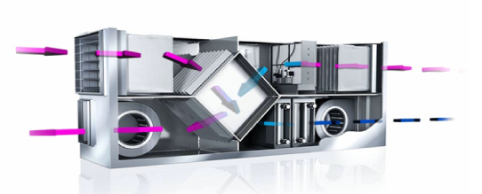
Approaches for Evaporative Cooling
Direct Evaporative Cooling
Conditions supply air for space
Increases moisture content in air
Indirect Evaporative Cooling
Conditions exhaust air before HX
Does not increase moisture content
HVAC
Direct Space
HVAC

Slide 29


Direct Evaporative Cooling

Slide 30
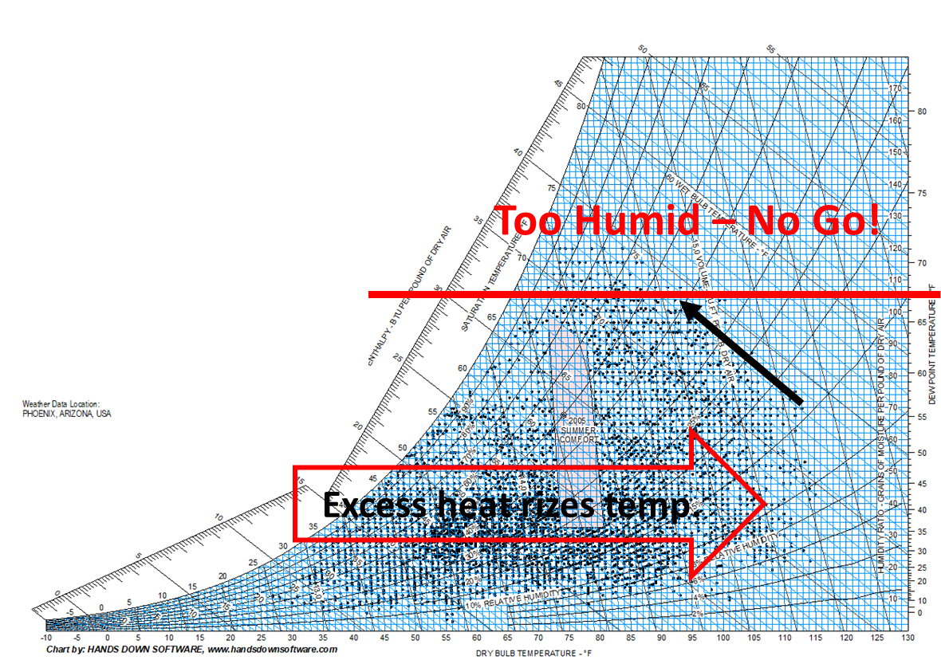
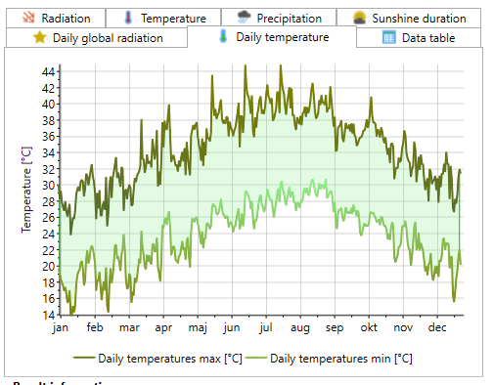
Who can Benefit from Direct Evaporative Cooling?
Main limiting factor for direct evaporative cooling is local Climate
As long as outside absolute humidity is below 70 gr/lb (10 g/kg) there is a good cooling potential.
Resulting max absolute should be kept < ≈100 gr/lb (13 g/kg)
The dryer it is, the more cooling is possible.

Slide 31
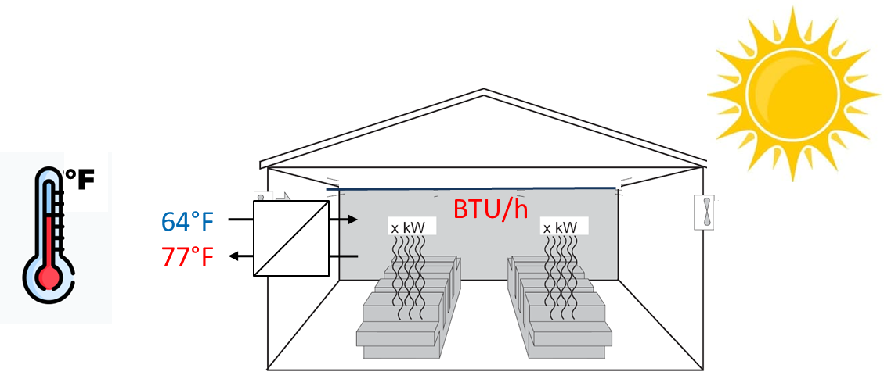
Increased Efficiency: Cooling Excess Heat
Any heat - from any source that increases the room temperature to a level above normal comfort temperature, of 20 – 25°C (72-77°F)
If exhaust temperature is higher than inlet temperature in a room, there is excess heat!
Excess heat can come from:
  Industrial processes, e.g. drying, casting, curing, chemical process.
  Impact from Solar radiation on the building
  People in the room

Slide 32

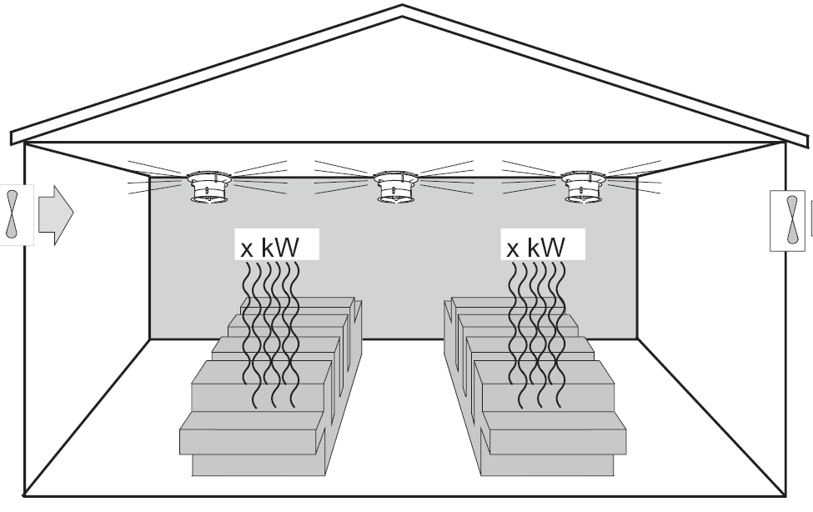
Direct Room Evaporative Cooling Example
Manufacturing Facility:
Warm Spring Day (Warm, not too damp)
Economizer Extension / Augmentation
Space Conditions:
125 kW machinery load
72°^{F} – 75°^{F} (22°^{C} – 24°^{C})
Max 60% RH
Air Handling Unit:
Variable up to 30000 cfm (50825 m³/hr)
Outside Air:
26 °^{C} (79°^{F})
@ 30 % RH
125 kW
Space Target:
24 -25 °^{C} (75°^{F} - 77°^{F}
Max. 60 % RH

Slide 33


Direct Room Evaporative Cooling Example
Maximum Ventilation Heat Load:
$$Q=\dot{m}C_{PAir}(T_{in}−T_{in})$$
$$\dot{m=}\frac{50825m^{3}}{hr}×\frac{1 hr}{3600s}×\frac{kg}{0.8808 m^{3}}=16 kg/s$$
$$Q=\frac{16 kg}{s}×\frac{1.006 kJ}{Kg∙K}×\left({26}^{°c}−{24}^{°c}\right)=32 kW (110\frac{BTU}{hr})$$
Equipment Load: 125 kW
Total Heat Load Equipment Load: 157 kW (536 kBTU/hr)

Slide 34
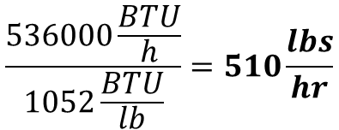
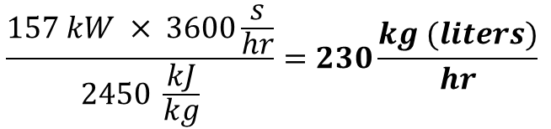
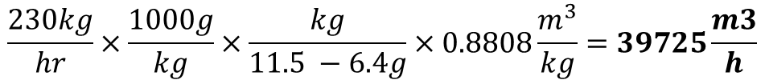
Direct Room Evaporative Cooling Example
  Needed fogging to absorb heat load:
$$\frac{157 kW × 3600\frac{s}{hr}}{2450 \frac{kJ}{kg}}=230\frac{kg (liters)}{hr}$$
$$\frac{536000\frac{BTU}{h}}{1052\frac{BTU}{lb}}=510\frac{lbs}{hr}$$
* Heat of Vaporization: Steam Tables at 22°^{C} / 72°^{F}
  Max humidity: 60% RH @ 24°^{C} (75°^{F}) = Absolute 11.5 g/kg (80 gr/lb)
  Outside air: 30% RH @ 26°^{C} (79°^{F}) = Absolute 6.4 g/kg (45 gr/lb)
$$\frac{230kg}{hr}×\frac{1000g}{kg}×\frac{kg}{11.5 −6.4g}×0.8808\frac{m^{3}}{kg}=39725\frac{m3}{h}$$
Retrofit Project? Compare with building ventilation capabilities.
$$\frac{510lb}{hr}×\frac{7000gr}{lb}×\frac{lb}{80 −45gr}×14.12\frac{{ft}^{3}}{lb}×\frac{hr}{60min}=24000 cfm$$

Slide 35






Direct Room Evaporative Cooling Example
  Iterate on result by using updated airflow. After 2 iterations:
$$Cooling=150 kW$$
$$Cooling=512\frac{kBTU}{hr}$$
$$Spray= 220\frac{kg (liters)}{hr}$$
$$Spray=485\frac{lbs}{hr}$$
$$Ventilation=39000\frac{m3}{h}$$
$$Ventilation=23000 cfm$$
  Energy Input: ~ 15W per kg/hr = 3.3 kW for Spraying
  EER = 150 / 3.3 = 45 EER

Slide 36
Direct Room Evaporative Cooling Example: Window Manufacturing

Slide 37
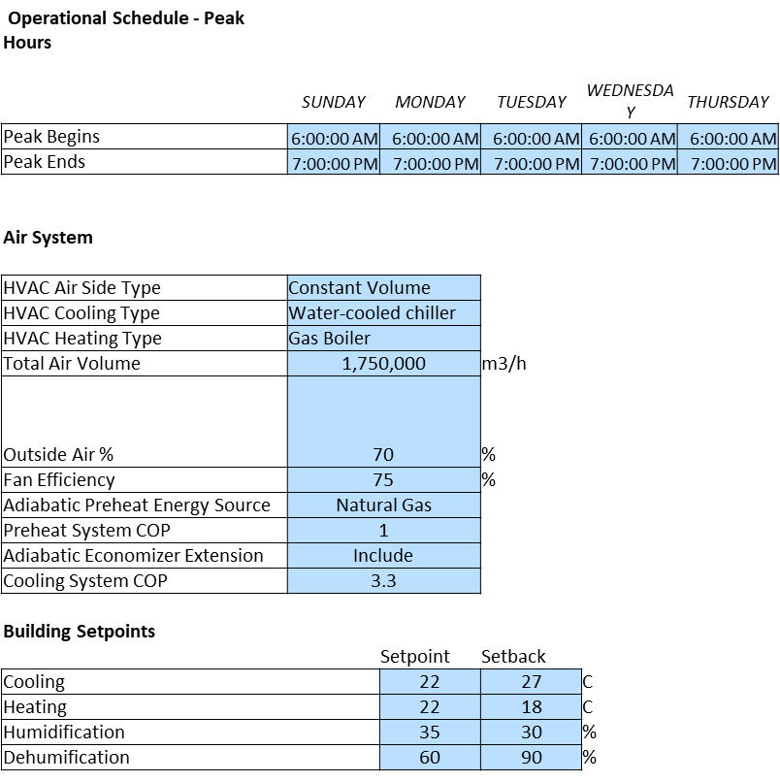
HVAC Humidification / Evaporative Cooling Example
Public Building Campus:
Southern Ontario
Existing older steam humidification
Energy cost reduction retrofit
Building Characteristics:
9 Floors
Multiple Air Handling Units
3 System Comparison
Resistive Steam
Gas Fired Steam
Hybrid Fogging

Slide 38
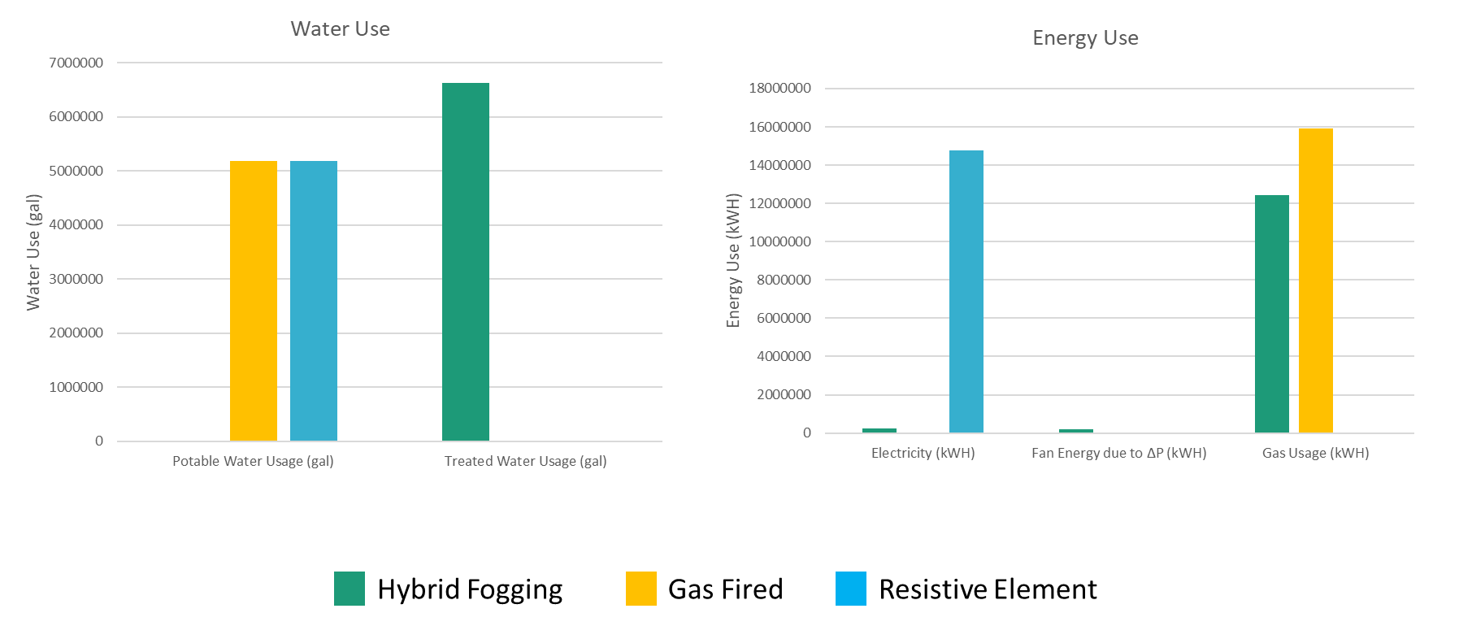
Case Study – Utility Usage

Slide 39
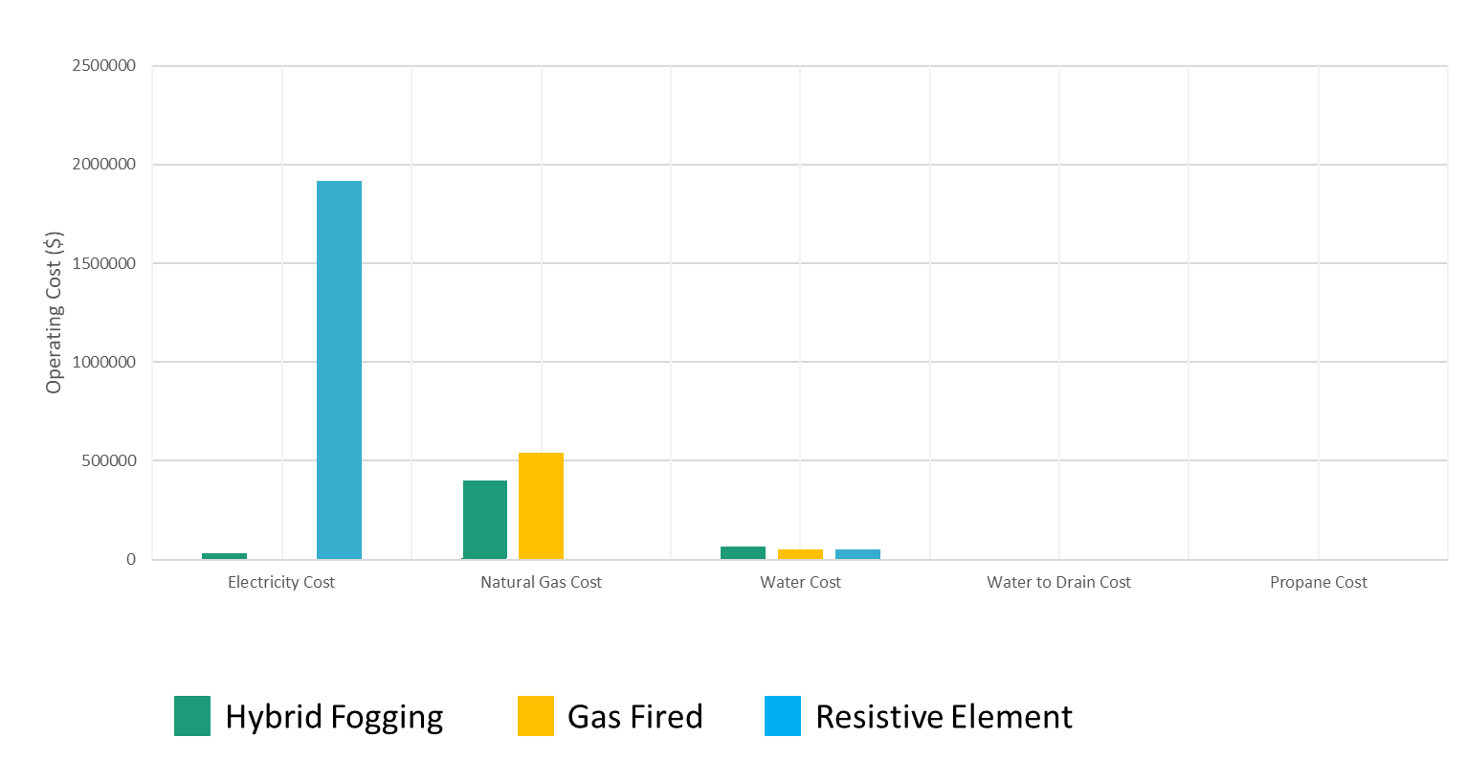
Case Study – Annual Costs

Slide 40
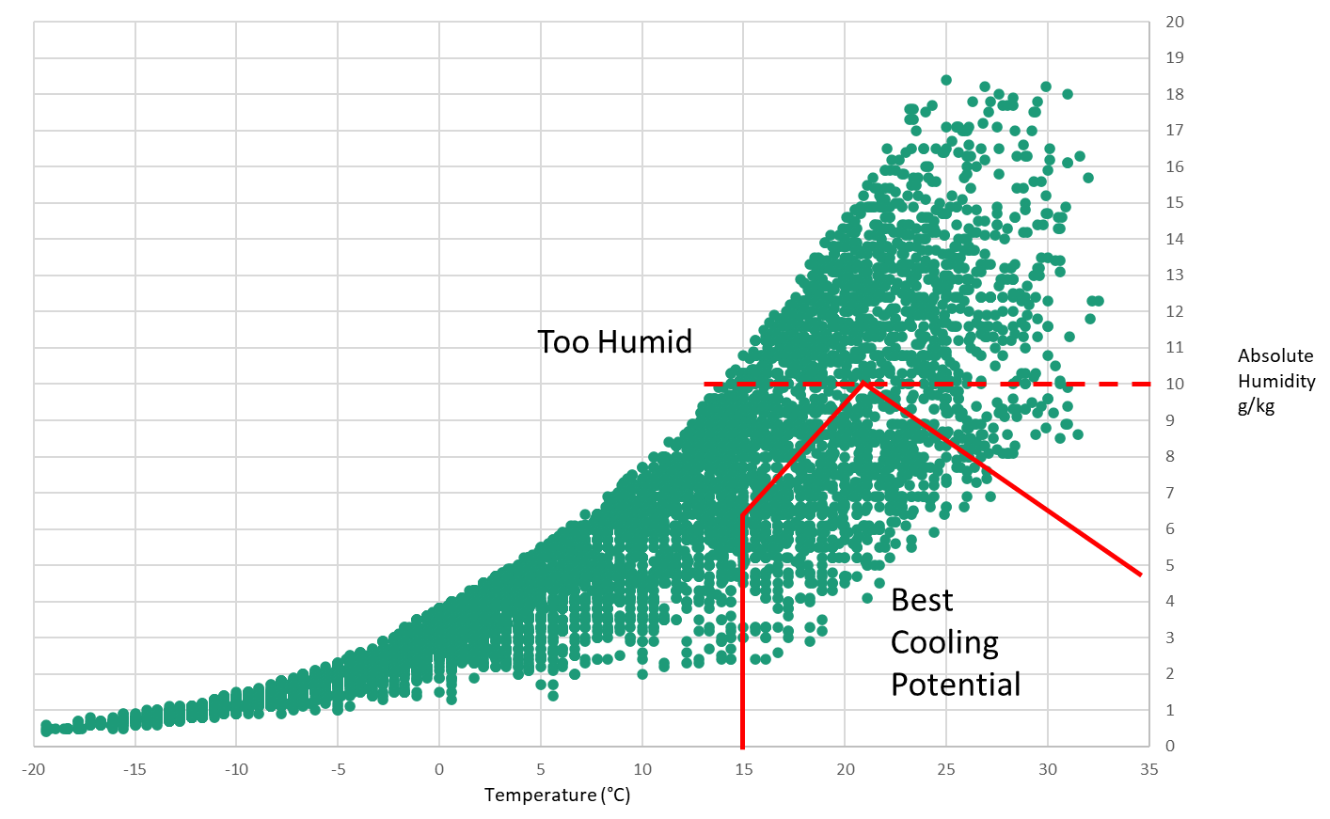
Example BIN Data Plot

Slide 41
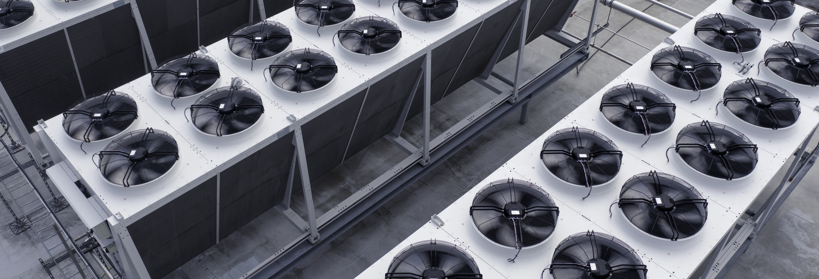
Indirect Evaporative Cooling

Slide 42
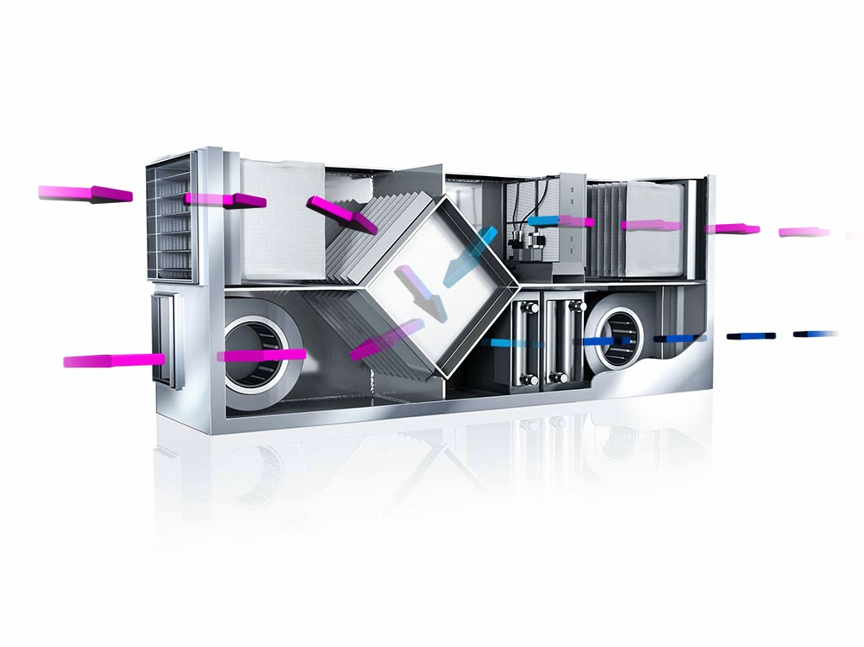
Indirect Evaporative Cooling Example
Building:
Toronto, ON
Monday - Friday
06:00 – 18:00
3120 Hours per year
Space Conditions:
72°^{F} – 77°^{F} (22°^{C} – 25°^{C})
Max 60% RH
Air Handling Unit:
15000 cfm (25500 m3/hr)
Supply at 64°^{F} – 68°^{F} (18°^{C} – 20°^{C})
72” W x 60” H (1830 x 1525 mm)
Plate Heat Recovery Efficiency: 70%
Fan Efficiencies: 65%

Slide 43
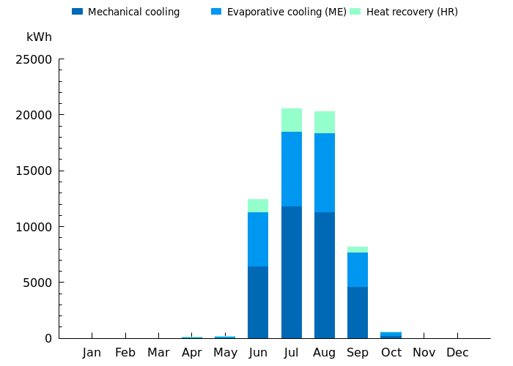
Indirect Evaporative Cooling Example
Cooling
Total: 62300 kWh
Mechanical: 34530 kWh (55.4%)
Evaporative: 22189 kWH (35.6%)
Heat Recovery: 5582 kWH (9%)
Evaporative Cooler
Capacity: 240 lbs/hr (110 l/hr)
Drain Factor: 7 lbs/hr (15 l/hr)
Annual Water: 16900 gal. (64 m³)
Operation: 811 hrs/yr
Additional Energy Input
Evap. Cooling: 287 kWh
Pressure Loss: 4520 kWH

Slide 44
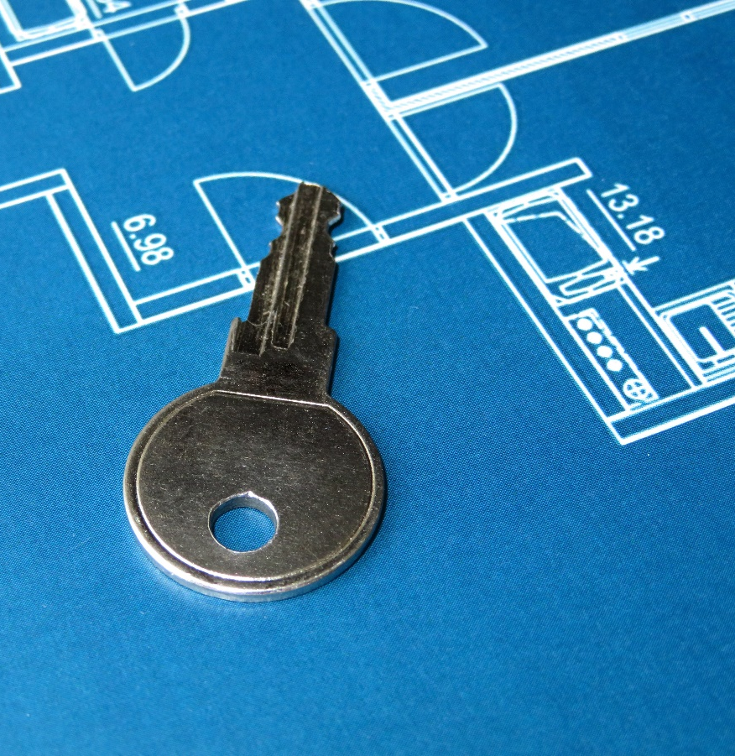
Keys to Success
Evaluate local climate for cooling hour opportunities
Humidification projects
  Consider winter preheat requirements
  Is there “free” heat in the building?
Consider interior design conditions – wider humidity ranges allow for more cooling
Does HVAC system have enough space: system + heat exchangers
Inlet water quality – water treatment often needed
Building energy modelling can help reveal more benefits

Slide 45

Evaporative Cooling / Adiabatic Technologies

Slide 46
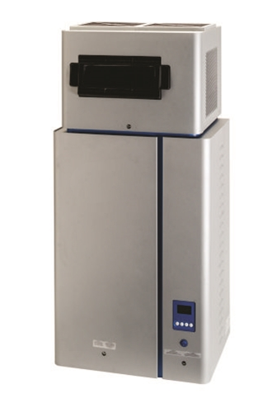
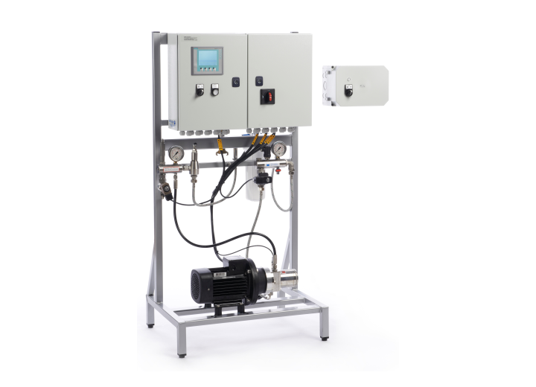
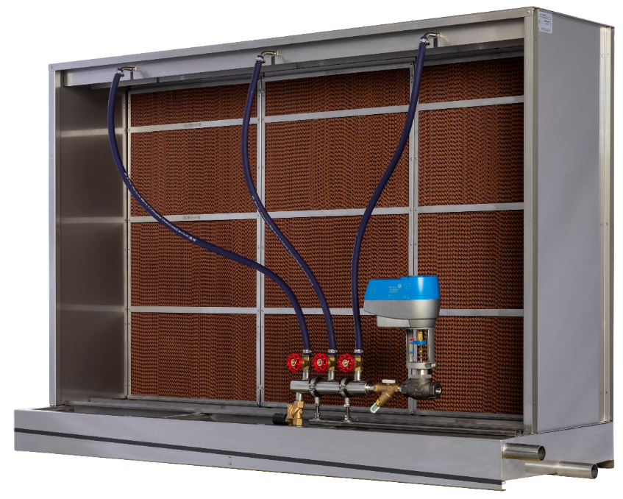
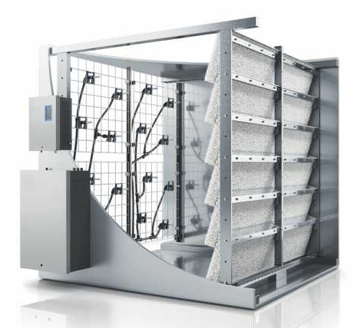
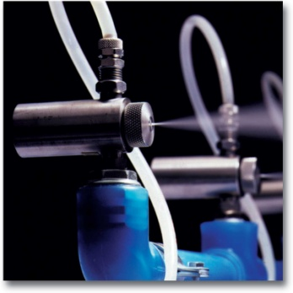
Commercial Adiabatic Humidifiers
 | Ultrasonic | Compressed Air Fogging | High-Pressure Fogging | Evaporative Media | Hybrid Fogging
Energy | Electricity | Compressed Air | Electricity | Electricity | Electricity
Water Type | RO, DI | Potable, RO, DI | RO, DI | Potable, RO | RO, DI
Capacity | 5 – 50 lb/h 2 – 23 kg/h | 5 – 1000+ lb/h 2 – 450+ kg/h | 200 – 3000+ lb/h 90 – 1300+ kg/h | 50 – 2000+ lb/h 22 – 900+ kg/h | 50 – 2000+ lb/h 23 – 900+ kg/h
Capital Cost | $$ | $ | $$ | $$$ | $$$
Operating Cost | $$ | $ | $$ | $ - $$$ | $$
Key Advantage | Packaged Product | Low costs | Largest capacities | Highest Cooling Performance | Compact Footprint
Images: Courtesy AHRI Member Companies

Slide 47
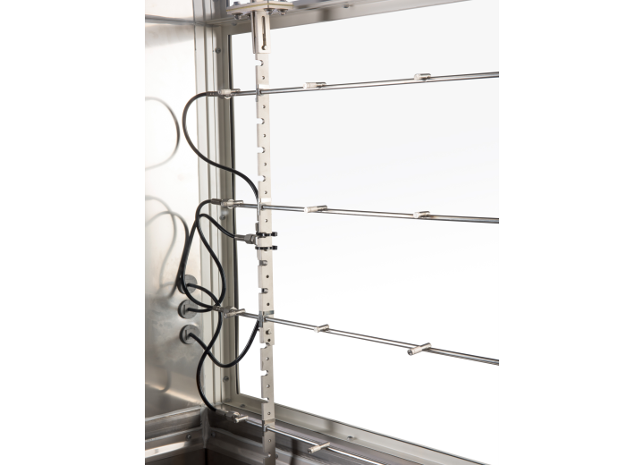
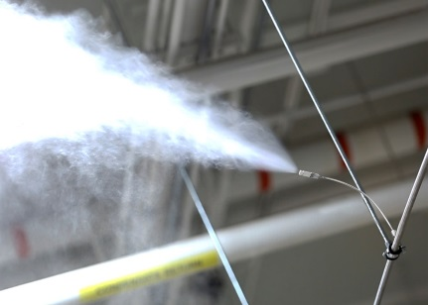
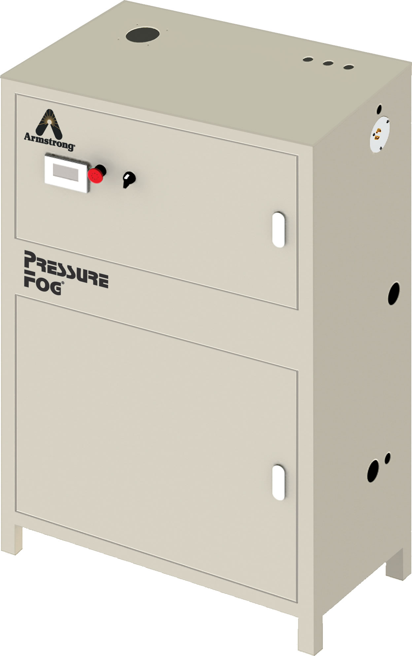
High Pressure Atomization
Applications
  Broadly applicable, many applications
  Direct room or ducted models
Advantages
  Scalable performance for large loads
  High-reliability, low maintenance
  Instant output / shutoff
  Higher accuracy than wetted media
Considerations
  Usually customized for application
  Treated water required
  Pump, Valves, Nozzles
  Staged control
Pressurized water (~1000 psi) is sprayed through small orifice nozzles to create a very fine mist

Slide 48
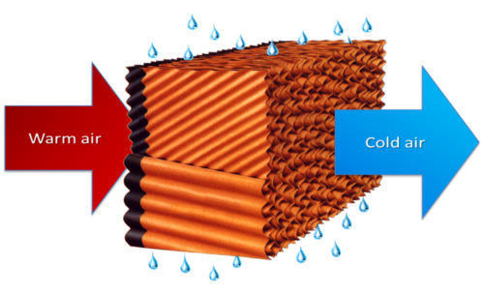
Wetted / Evaporative Media
Applications
  Data Center Cooling
  General humidification/cooling
Advantages
  Scalable performance for large loads
  Highest cooling performance
  Works with Potable/Softened/RO water
  Low-cost operation
  No evaporation distance
Considerations
  Media is consumable
  Slower response times/accuracy
  Hygiene and water quality
  Not suitable for healthcare
  Air pressure drop across media
Water is pumped over a specialized filter media. Air passing through the media evaporates water.

Slide 49
Hybrid Fogging
Applications
  General humidification/cooling
  Airports, Auditoriums, Large Facilities
Advantages
  Scalable performance for large loads
  Smaller footprint than fogging alone
  Low-cost operation
Considerations
  Treated water (RO/DI) required
  Wet section with drain required
Water is sprayed onto a specialized filter media. Air evaporates both the fog and droplets in the media.
Water is sprayed onto a specialized filter media. Air evaporates both the fog and droplets in the media.

Slide 50
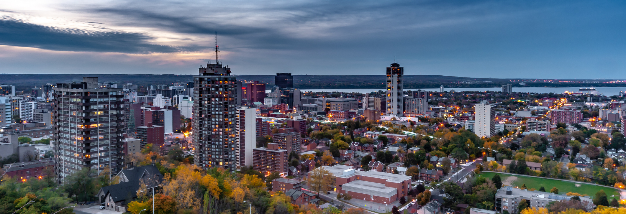
Summary

Slide 51
Summary
Humidity control is needed in many buildings, especially during the winter months
In Ontario, many technologies are viable for decarbonization through electrification options
Adiabatic / Evaporative cooling takes decarbonization a step further by reducing cooling loads
  Direct Evaporative systems can be applied directly in the space or an HVAC system
  Indirect systems work with HVAC system and heat exchanger
There are evaporative technologies available for all sides of application
New hybrid technologies combine the benefits of evaporative and fogging
Consider an evaporative / adiabatic system for your next project!

Slide 52
Questions?
Thank-you for your time and attention!
Nicholas Lea, P. Eng, LEED AP BD+C
Head of Product and Sales Support Americas
Condair Ltd.
Nicholas.lea@condair.com
1 800 667 8321

